Slide 1
Openshift Starter
Srinivasan K Santhanakrishnan
Monday, 4 May 2020

Slide 2
Agenda
What is Open Shift?
Openshift Architecture
Openshift Deployment Modes
Virtual box Vs Hyper Virtualization
Installing and working with Minishift
Sample Python Project Deployment
Build Strategies and Build Config
Build using Docker Strategy
Deployment Strategies and Deployment Config
Deploy the Docker Build created
Networking, Services and Routes
Creating a Service for the Docker Deployment done
Creating a Route for the Service created
End to End Multi layer Project Deployment (Python – Redis – Postgres – Java – NodeJS) – If time permits. Otherwise it will be part 2.

Slide 3
What is Openshift
Openshift is a Container Platform As-a Service (C-Paas)
Openshift Origin: Original Open Source Container Platform
- For this session
- Based on Docker containers and Kubernetes Cluster Management
- Plus has its own tools for a complete container platform.
Openshift Online: Openshift on Public Cloud by Redhat
Openshift Dedicated: Openshift Managed on private cloud like GCP and AWS
Openshift Enterprise: Openshift in private and On-premise C-PaaS

Slide 4
Openshift Architecture
Openshift Tools: CICD, Git, Openshift Container Registry (OCR), Networks, API and Governance
Docker Containers are deployed and managed by the Kubernetes Cluster
Docker Containers

Slide 5
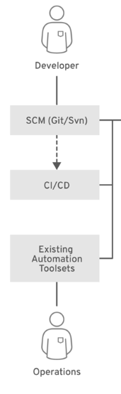
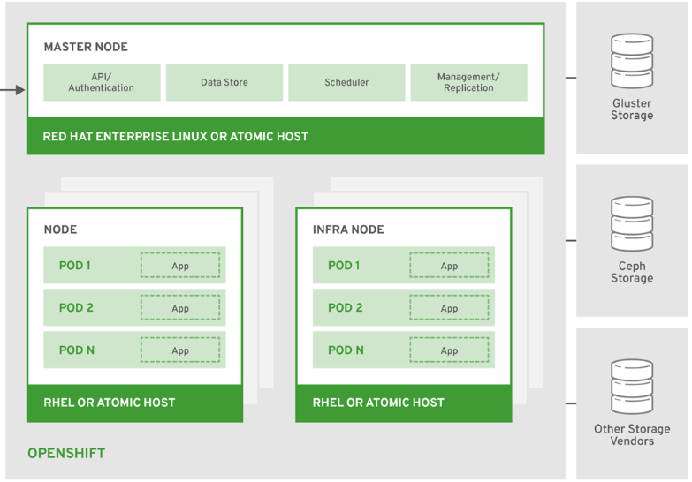
Openshift Architecture

Slide 6
Openshift Deployment Modes
All in One
(Master and Worker in one system)
Single Master and Multiple Worker
Multiple Master and Multiple Worker
Recommended
only for DEV
Recommended for PROD
Minishift Single Node Cluster
When you run Minishift, it is going to pull a docker image from the
Docker Hub and run it as a container.
For this session we will use Minishift
Docker Registry
Web Console App
Openshift Origin
Router

Slide 7
Installing and starting Minishift
Install Virtualbox - https://www.virtualbox.org/wiki/Downloads
Download Minishift - https://docs.okd.io/3.11/minishift/getting-started/preparing-to-install.html
You can run Minishift either in Hyper-v or Virtualbox. For this session, we will use Virtualbox as this is more reliable than Hyper-v.
Check Hyper-v is disabled. If not, disable and execute bcdedit /set hypervisorlaunchtype off in the windows powershell and restart your computer. Note, you need to run the powershell in admin mode. For enabling the Hyper-v, enable the Hyper-v feature and run the command bcdedit /set hypervisorlaunchtype auto in the windows powershell and restart your computer.
Open a command prompt, run minishift.exe start --vm-driver virtualbox.
Run minishift oc-env - Copy the path command and execute it in the same command prompt.
It will take up to 10 minutes to start the minishift cluster. Make sure you are connected to internet.

Slide 8
Accessing Minishift
Openshift REST API
Openshift CLI – command oc <<options>>
Openshift Web Console – We will use this option for this session.
Minishift console – will open the web console in the default browser

Slide 9
Project Creation and Deployment
Project Demo. Python
Github : https://github.com/sriniks25/py

Slide 10
Build Strategies and Build Config
Source to Image Build:
Pre built python image → Inject the python code → Final Image
2. Docker Build :
Need to create deployment config, service config and route config
2.1 Create build config yaml, import
2.2 Create deployment config yaml, Import
2.3 Create service config yaml, Import
2.4 Create a route
3. Custom Build (This session will not cover this)
Build Config
Deploy Config
Service Config
Route Config

Slide 11
Deployment Strategies
Rolling (Default) – For multiple replicas, the deployment will update the replicas one at a time
2. Recreate – Multiple replicas are down at one go and new replicas are created at one go
3. Blue/Green – Existing: Blue, New: Green. Both deployed at a same time. Once testing is completed in Green, switch the LB to point to Green and remove Blue
4. A/B Pattern – A: Existing, B: New. Both deployed at a same time. Gradually increase the traffic of B.
A:80% / B:20% → A:60% / B:40% → A:40% / B:60% → A:20% / B:80% → B:100%
Triggers for Deployment – CLI, Manual and Image Change

Slide 12
Deployment Config
https://docs.okd.io/1.5/dev_guide/deployments/how_deployments_work.html
Copy the Deployment Config Template Yaml
Modify name, label and docker image, replica number, triggers

Slide 13
Networking in Openshift
Similar to Kubernetes Network:
Each worker node is assigned a unique IP address
The Pod running on a node is assigned a unique IP address.
Multiple Pods comes under a same network in order to communicate with each other
Run oc get pods –o wide to get the pods and its IP address
5. Openshift DNS provides a way to connect to the Pods using service name instead of IP address
Master node
a.b.c.d
Worker node 1
10.128.0.0
Worker node 2
10.128.2.0
Worker node 3
10.128.4.0
Pod 1
App1
10.128.0.2
Pod 2
App2
10.128.2.2
Pod 3
App3
10.128.4.2
Openshift Software Defined Network (SDN) – assigns and manages the IP address
Default IP: 10.128.0.0

Slide 14
Service and Routes
External System
Service is used to connect between pods and to the external system.
Rely on service names instead of IP address
Each Service is assigned an internal IP address (cluster IP) and a Name
Route is similar to a proxy that exposes a service to outside world
LB strategy – Round Robin, Least Connection, Source (Default)
For Service yaml template
https://docs.okd.io/3.6/architecture/core_concepts/pods_and_services.html
Once imported, open virtual box command prompt, login with docker/tcuser and run the curl http://<<service-ip>>:<<port>>
7. Click on Create Route link to create a route
Route
www.abc.com
Route:
Security
LB
Service
10.128.4.1
Selector: deploymentconfig=py-app
Listening Port 8080
Pod 1
App: py-app-srini
10.128.2.2
Port 8080

